Slide 1


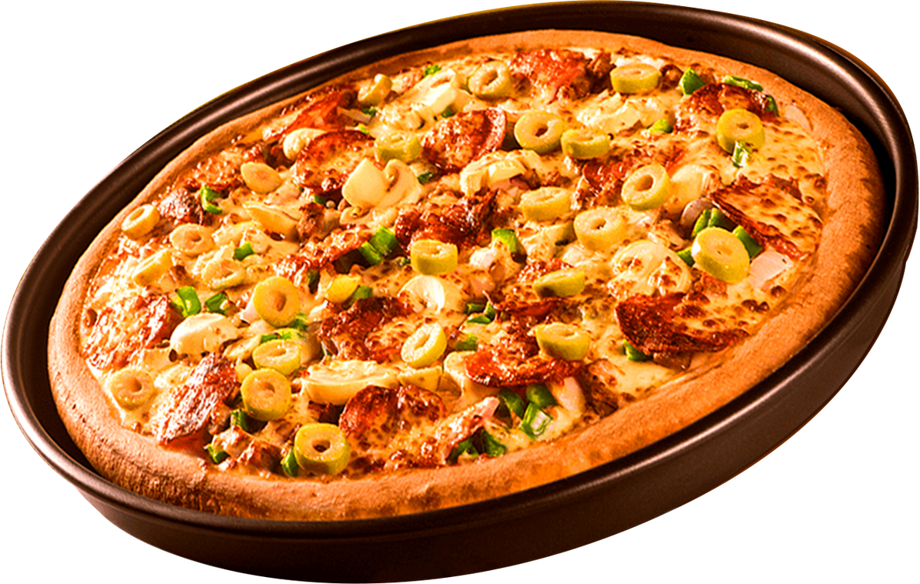


Home
Contact
PIZZA SALES ANALYSIS
1

Slide 2

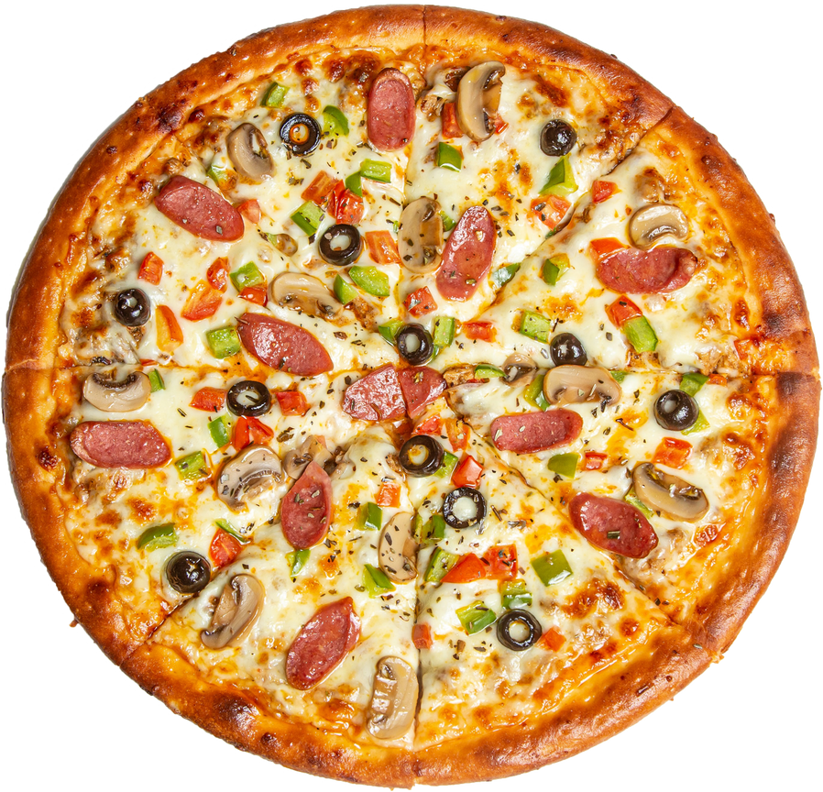
Home
About
Contact
ABOUT ME
I am Hemant Kumar. In my Pizza Sales Analysis project using MySQL, I overcame challenges with data joins and performance optimization to uncover valuable insights on product demand, peak hours, and revenue share—enabling strategic, data-driven decisions for sales improvement.
2

Slide 3
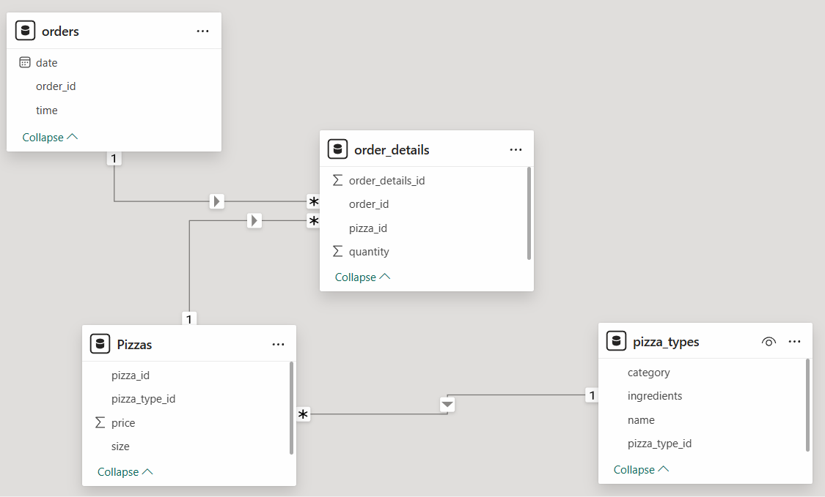
DATA MODELLING
Home
About
Contact
01
02
03
04
3

Slide 4
Home
About
Contact
The Pizza Sales dataset includes multiple interlinked CSV files capturing detailed transactional data from a pizza restaurant. It contains information on pizza types, prices, sizes, order quantities, timestamps, and itemized order details. These structured datasets support relational joins and time-series analysis, enabling insights into customer preferences, revenue trends, and peak ordering times. This makes it ideal for practicing real-world SQL analytics and generating actionable business intelligence for data-driven decision-making.
PIZZAHUT DATASETS
$30
$30
4

Slide 5
ANALYSIS PART
Home
About
Contact
1. Retrieve the total number of orders placed.
2. Calculate the total revenue generated from pizza sales.
3. Identify the highest-priced pizza.
4. Identify the most common pizza size ordered.
5.List the top 5 most ordered pizza types along with their quantities
6. Join the necessary tables to find the total quantity of each pizza category ordered.
7. Determine the distribution of orders by hour of the day.
8. Join relevant tables to find the category-wise distribution of pizzas.
9. Group the orders by date and calculate the average number of pizzas ordered per day.
10. Determine the top 3 most ordered pizza types based on revenue.
11. Calculate the percentage contribution of each pizza type to total revenue.
$30
$30
5

Slide 6
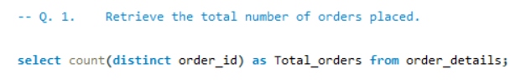

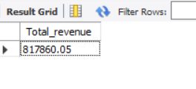
6

Slide 7
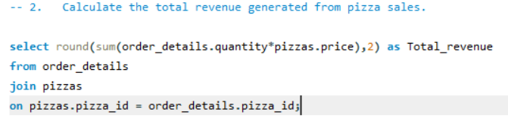
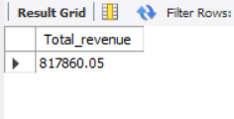
7

Slide 8
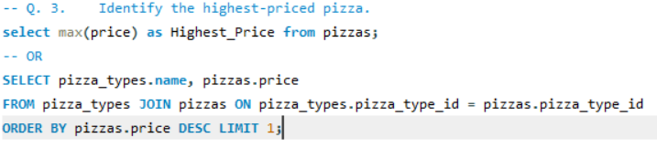
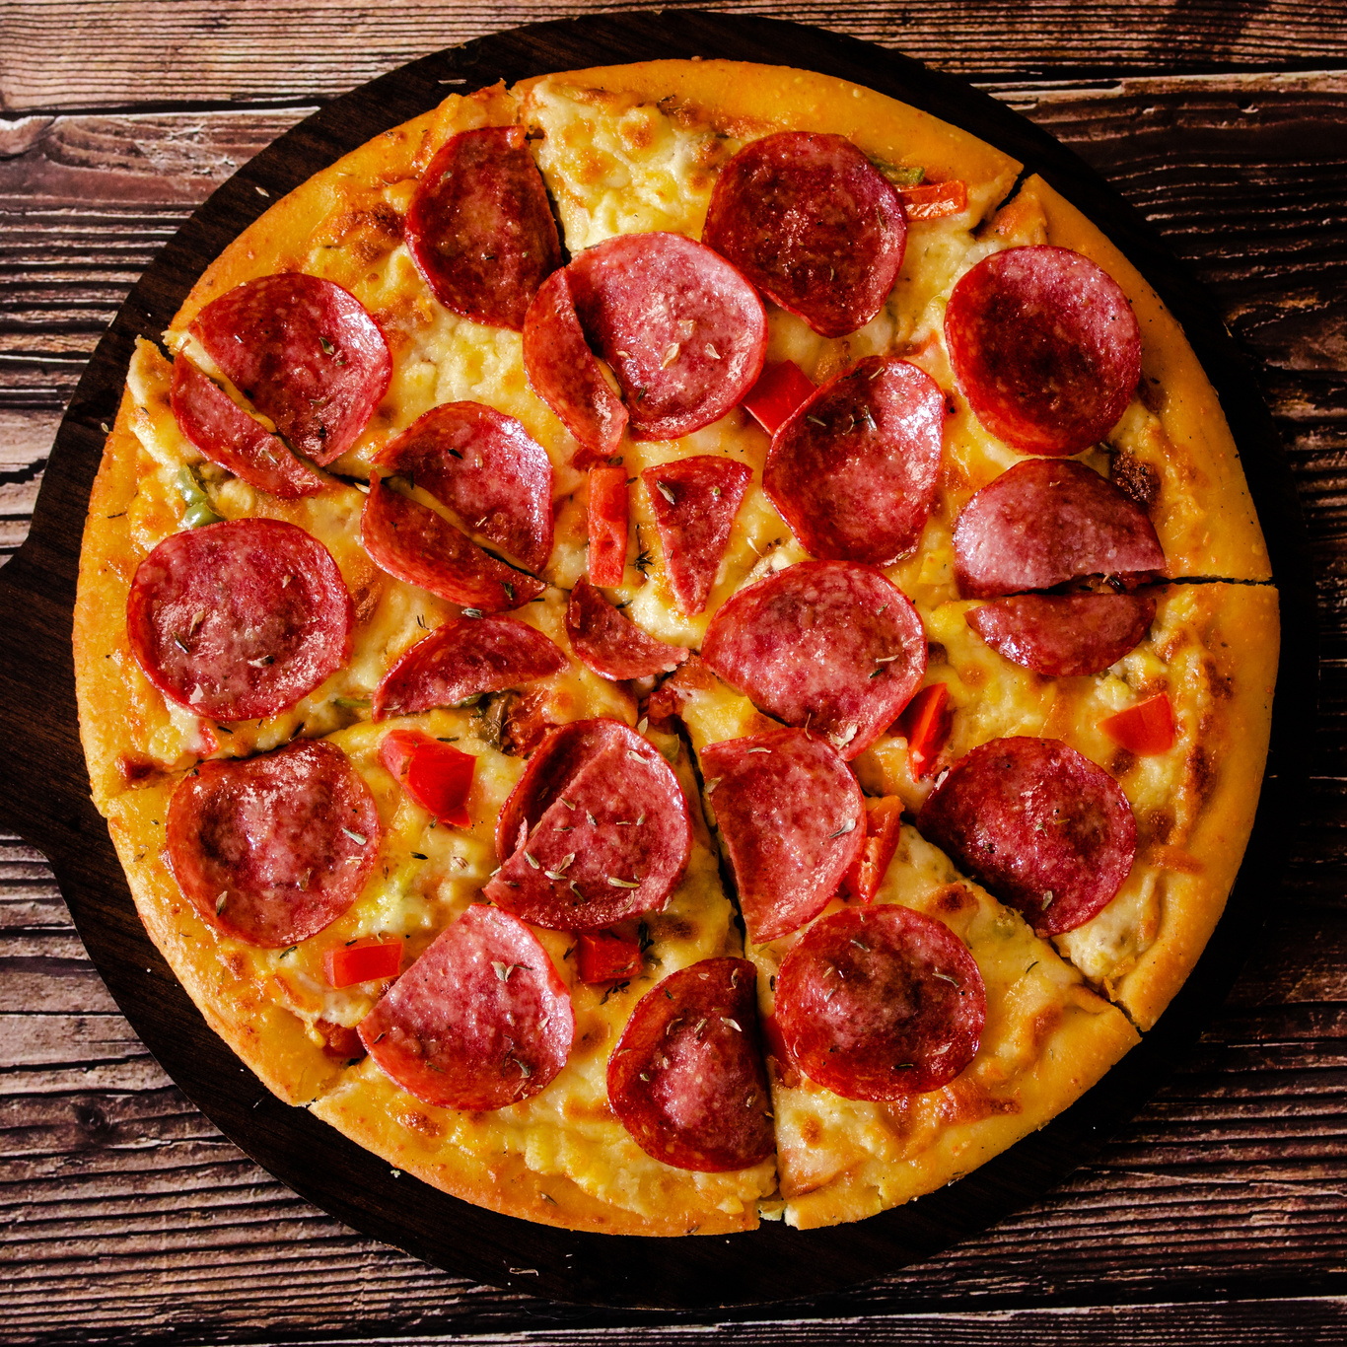
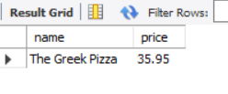
8

Slide 9
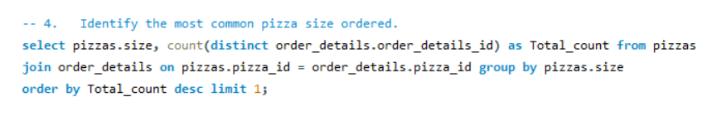

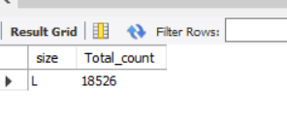
Contact
9

Slide 10
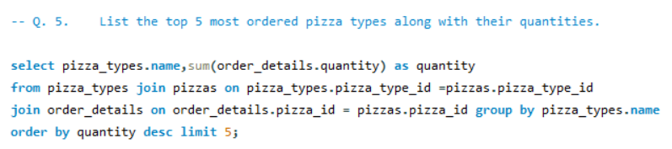
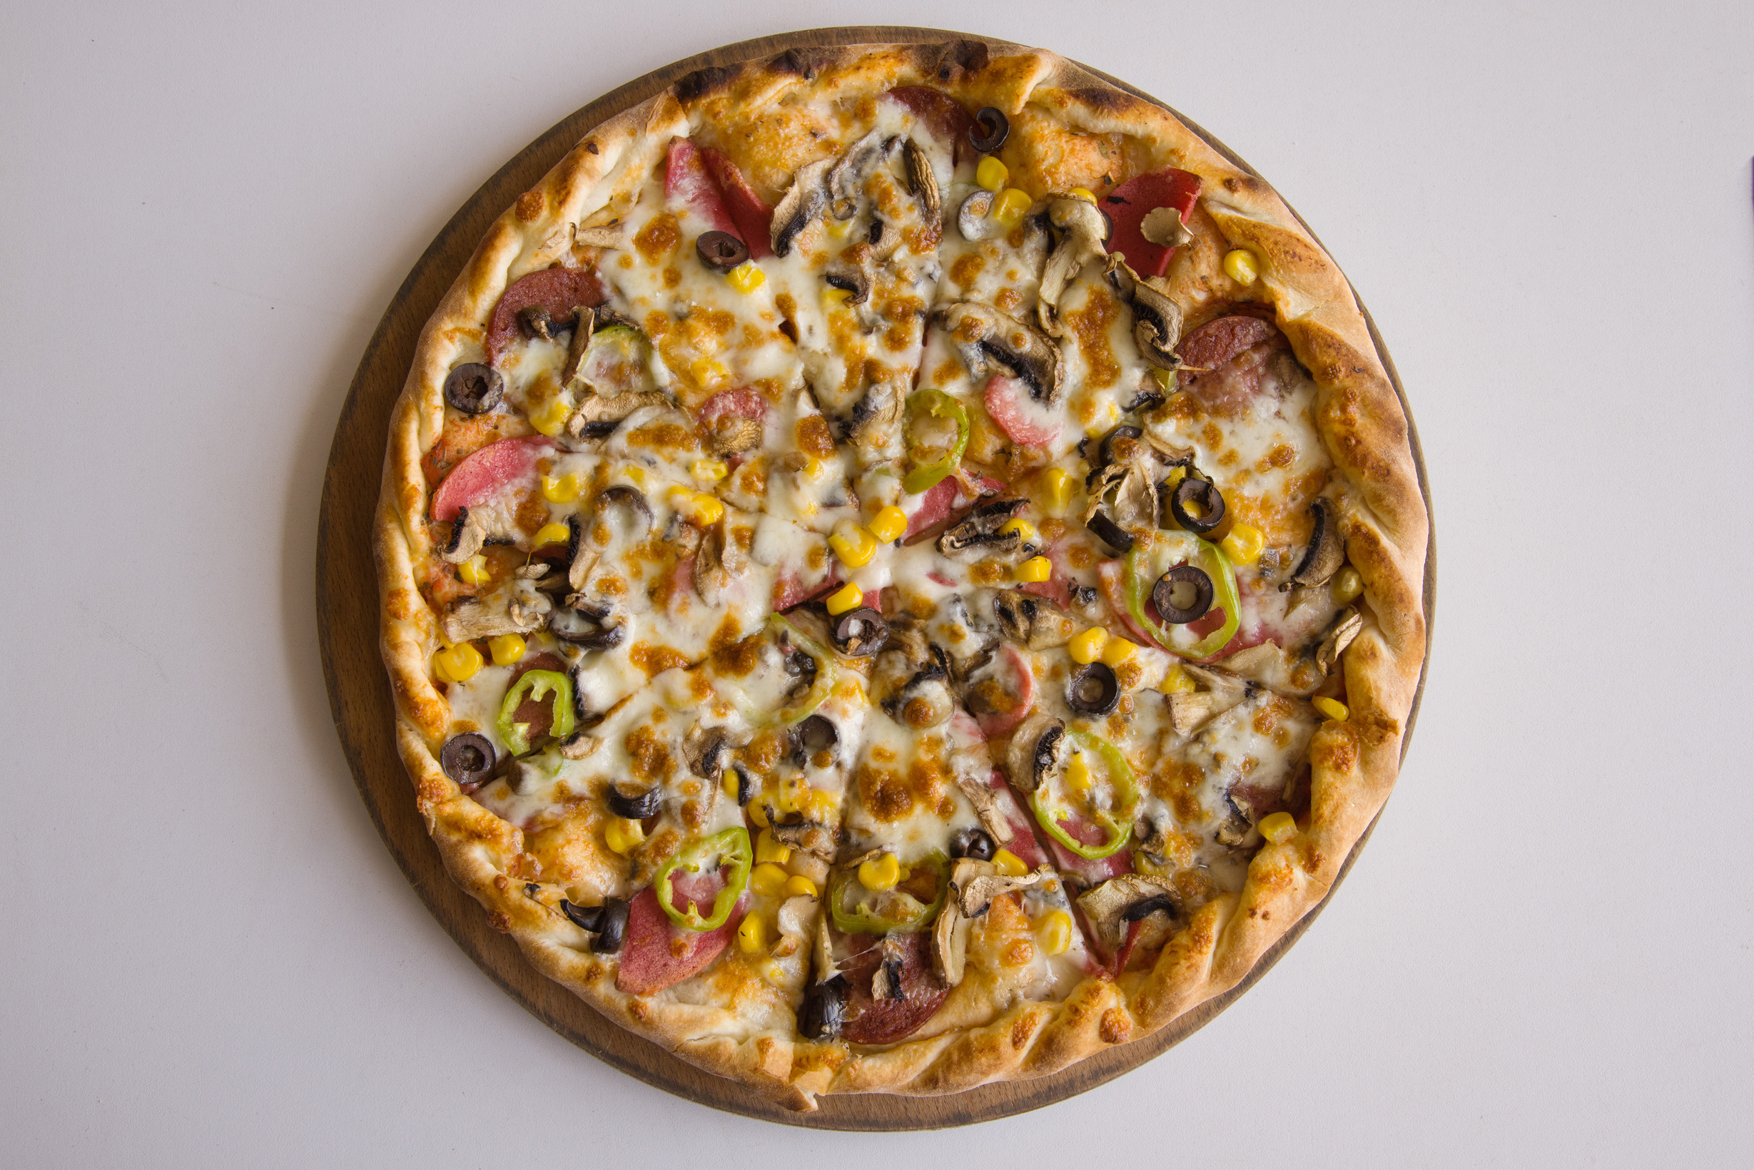
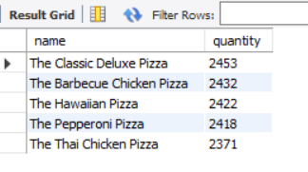
$30
10

Slide 11
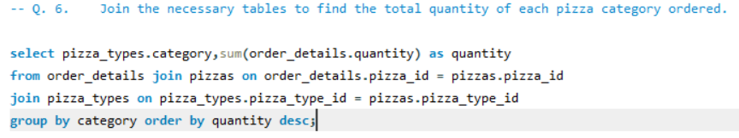
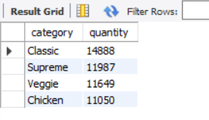
11

Slide 12
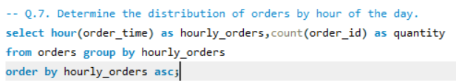
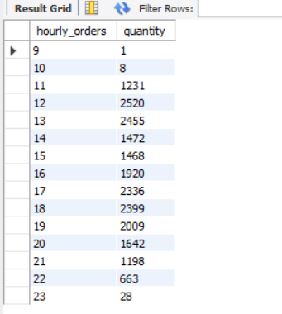
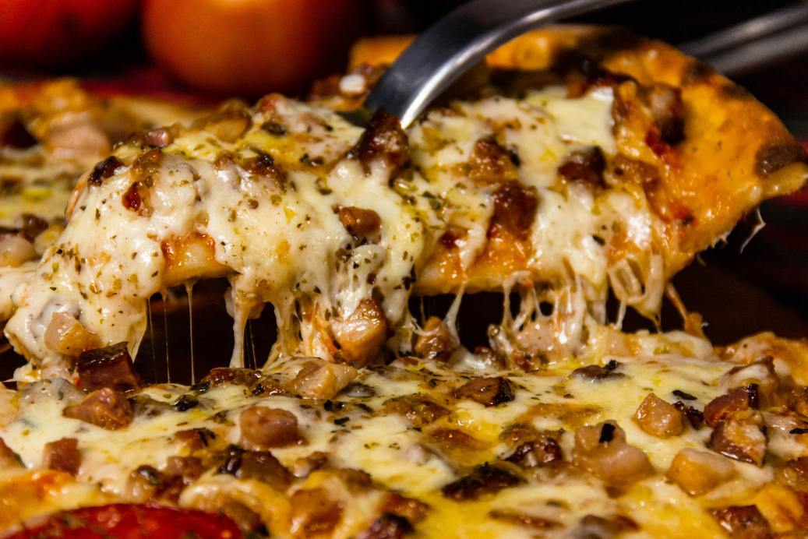
Contact
12

Slide 13
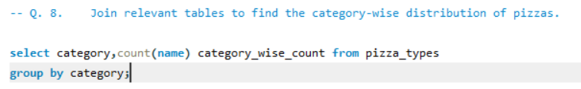
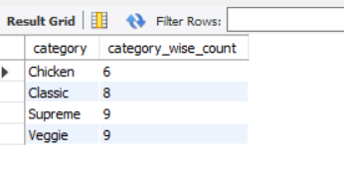
13

Slide 14
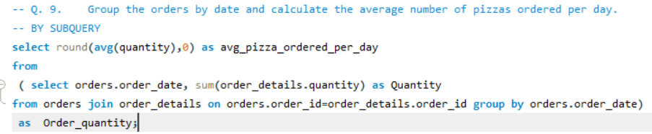
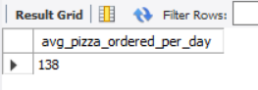
Contact
14

Slide 15
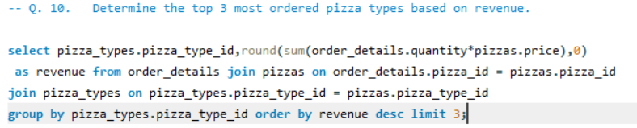
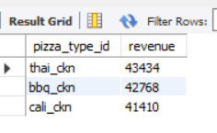
15

Slide 16
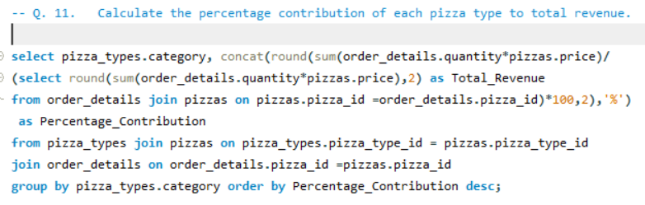
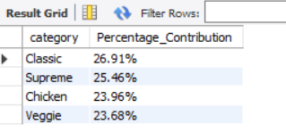
Contact
16

Slide 17
Home
About
Contact
CONCLUSION
This project provided valuable hands-on experience in SQL-based data analysis, enhancing my ability to extract actionable insights from real-world datasets. By analyzing pizza sales across various dimensions—time, product, and revenue—I gained a deeper understanding of customer behavior and business performance. The project demonstrated how structured data and well-crafted queries can drive strategic decision-making, optimize operations, and support growth in the food retail industry.
17

Slide 18
Home
About
Contact
THANK YOU
HEMANT KUMAR
18

